Slide 1
Matrices Applied in Cryptography
Matrices Applied in Cryptology
Team 13
INDEX.HTML
Notes:
Good morning, everyone! We’re Team 13, and today we’re going to talk about how we applied matrices in cryptography. So, before we start the presentation, let me ask all of you a question:
Have you ever used the same passwords across multiple accounts just because it was easier to remember? If your answer is yes, please hold onto that thought.

Slide 2
TABLE OF CONTENTS
01
MOTIVATION
02
METHOD
03
EVALUATION
04
CONCLUSION
TABLE OF CONTENTS
Why this topic?
Introduce the code written
Evaluate encrypted passwords
Conclusion & References
TABLEOFCONTENTS.HTML
Notes:
The table of contents are as below. We’ll give a brief introduction on our motivation, then we’ll move on to our methods, and then our evaluation and conclusion.

Slide 3
01
MOTIVATION
MATRICES APPLIED IN CRYPTOGRAPHY
Find creating passwords annoying?
MOTIVATION.HTML

Slide 4
Motivation
MATRICES APPLIED IN CRYPTOGRAPHY
Different accounts with all passwords the same.
⇒ credential stuffing
New password is easily forgotten.
MOTIVATION.HTML

Slide 5

02
METHODS
MATRICES APPLIED IN CRYPTOGRAPHY
Start coding!!
our code link : https://replit.com/@annguo1106/password#main.c
METHODS.HTML

Slide 6
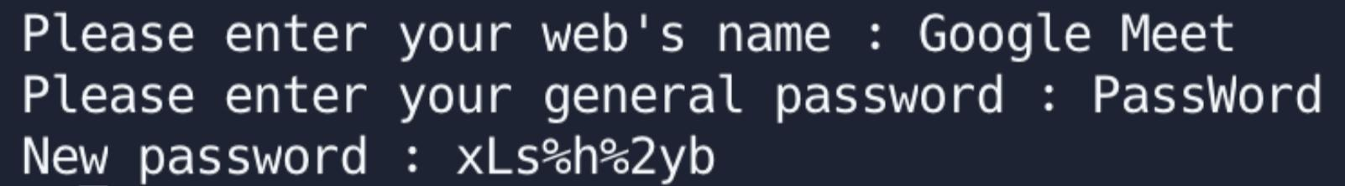
INTRODUCTION
Enter web name and general password users usually used
2. Encryption using matrix multiplication
3. Then we can get a new password with higher security!
METHODS.HTML

Slide 7

Step 1
MATRICES APPLIED IN CRYPTOGRAPHY
We create a special sentence by hand to build the web key. The web key is used to generate the matrix A, which is going to be used to encode the general password later.
METHODS.HTML

Slide 8
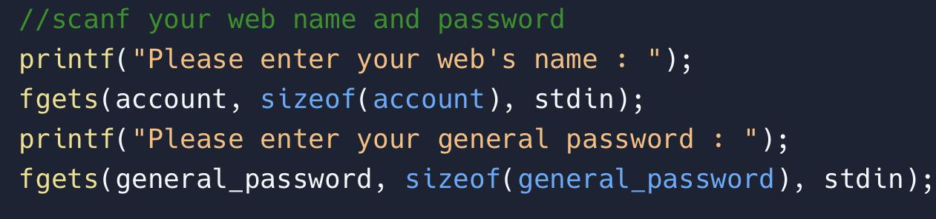
Step 2
MATRICES APPLIED IN CRYPTOGRAPHY
Enter user’s general web account username and password.
METHODS.HTML

Slide 9
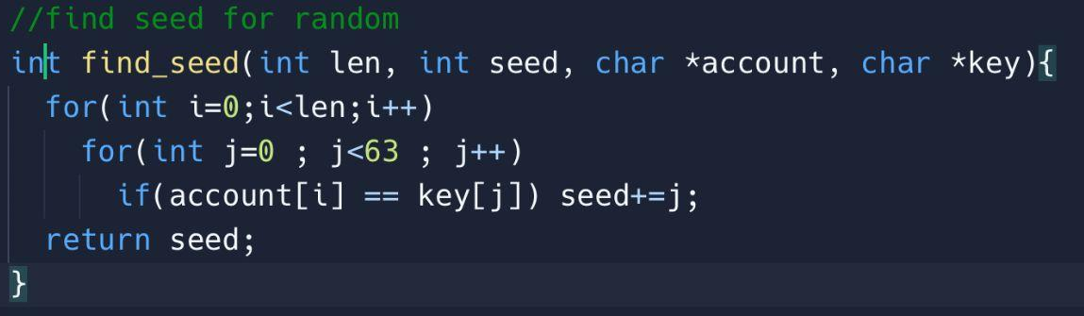

Step 3.1
MATRICES APPLIED IN CRYPTOGRAPHY
The web name will correspond to a group of numbers in the web key.
METHODS.HTML

Slide 10
Step 3.2 - Example
MATRICES APPLIED IN CRYPTOGRAPHY
index | 0 | 1 | 2 | 3 | 4 | 5
ExampleKey | G | e | o | l | m | t
web name : Google meet
index correspond in Example Key : 0220314115
(Remove blank)
METHODS.HTML

Slide 11

Step 4.1
MATRICES APPLIED IN CRYPTOGRAPHY
We use that group of numbers as a seed of the random function, and generate a random number w.
EVALUATION.HTML

Slide 12
Step 4.2
MATRICES APPLIED IN CRYPTOGRAPHY
Let Rows of matrix A = (w % length of password) + length of password
(Columns of matrix A = length of password.)
ensure A is not invertible
(number of rows ≠ the number of columns.)
METHODS.HTML

Slide 13
Step 5
MATRICES APPLIED IN CRYPTOGRAPHY
Generate encryption matrix and use Key to fill it.
-> according to step 4, the matrix is non-square so it is not invertible at the same time.
METHODS.HTML

Slide 14
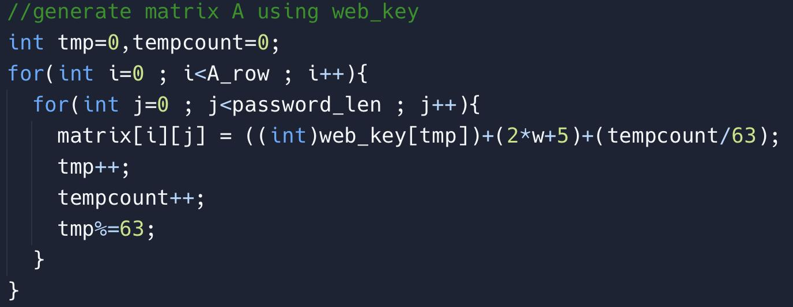
Step 5-code
MATRICES APPLIED IN CRYPTOGRAPHY
METHODS.HTML

Slide 15
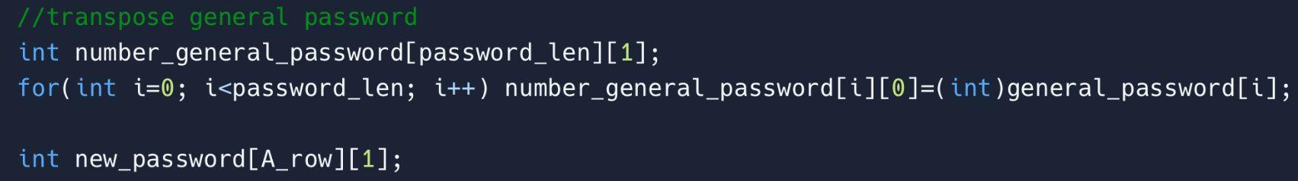
Step 6
MATRICES APPLIED IN CRYPTOGRAPHY
Convert general password from type of char to type of int by using ascii code. And transform it.
METHODS.HTML

Slide 16
Step 7
MATRICES APPLIED IN CRYPTOGRAPHY
Do matrix multiplication of the encrypted matrix generated in Step 5 and the number string generated in Step 6.
encrypted matrix
general string in type of int
new
password
!!!
METHODS.HTML

Slide 17
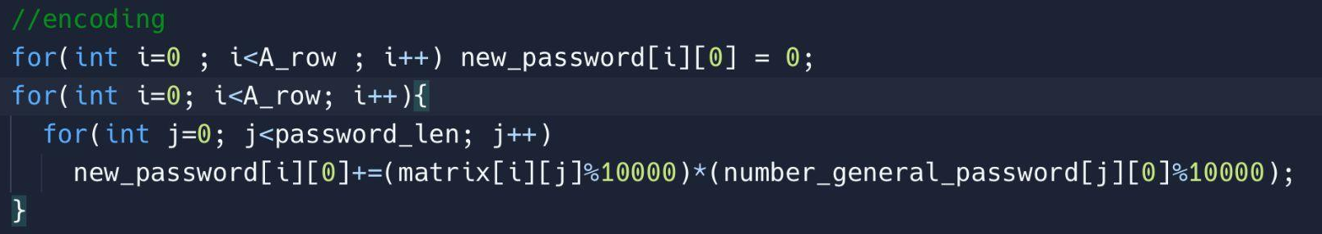
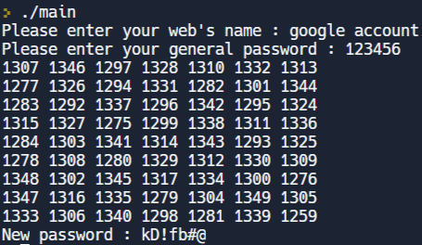
Step 7-code
example of matrix A
MATRICES APPLIED IN CRYPTOGRAPHY
METHODS.HTML

Slide 18
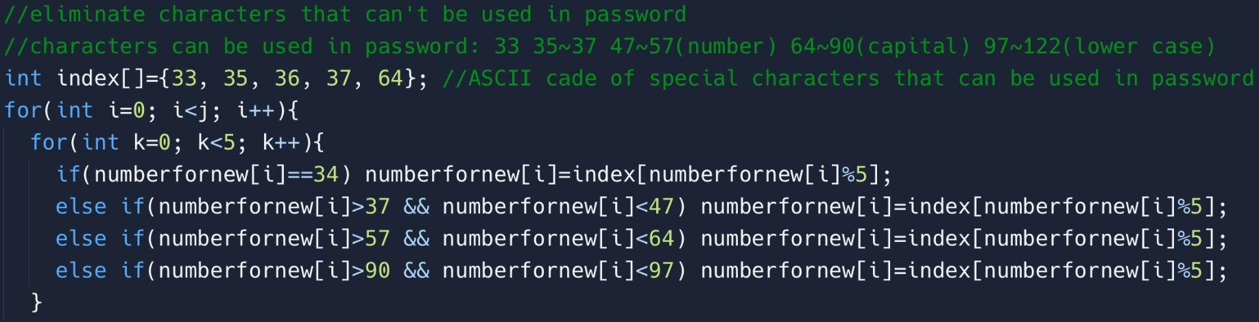
Step 8
MATRICES APPLIED IN CRYPTOGRAPHY
Remove characters that cannot be used as a password in the string generated in Step 7 to get the final new password.
METHODS.HTML

Slide 19
Special advantage
different computers ⇒ different random numbers
⇒ password will not be known by others
same computer ⇒ same random numbers
⇒ able to get the same encoded password
Notes:
the random number will be different on each computer. But the number will be consistent on the same computer.
so we can ensure that we are able to get the same encoded password and this encoded password will not be known by others although they have our general password at the same time.

Slide 20
03
EVALUATION
MATRICES APPLIED IN CRYPTOGRAPHY
We have completed a project!
But how do we know that the product is useful?
EVALUATION.HTML

Slide 21
PROCESS OF EVALUATION
MATRICES APPLIED IN CRYPTOGRAPHY
SURVEY
TEST
VALIDATION
CONCLUSION
Survey on generating passwords manually
Password Strength test from UIC ACCC
Research paper from CMU CUPS
Conclusion
EVALUATION.HTML
Notes:
UIC ACCC: Academic Computing and Communications Center of the University of Illinois Chicago
CMU CUPS: CyLab Usable Privacy and Security Laboratory of Carnegie Mellon University

Slide 22
SURVEY
MATRICES APPLIED IN CRYPTOGRAPHY
Ask the respondents to provide 3 passwords:
Social media account, Phone unlocking, E-mail
Rules of password generation:
Password length is preset to popular regulations
Arabic numerals, upper/lower case letters, and special characters (e.g., #, %, $, @) are acceptable.
EVALUATION.HTML

Slide 23
RESULT
MATRICES APPLIED IN CRYPTOGRAPHY
Result of the Survey
34 responses in total, with 1 response eliminated due to rule violation.
EVALUATION.HTML

Slide 24
ENCRYPTION
MATRICES APPLIED IN CRYPTOGRAPHY
EXAMPLE:
TYPE (web name) | ORIGINAL PWD | ENCRYPTED
SOCIAL (account) | password | LNPe8Nhog
E-MAIL (email) | zxcvbn08 | @a2mi@Fl0
PHONE (phone) | 20221208 | Rt%@9tTt$
EVALUATION.HTML

Slide 25
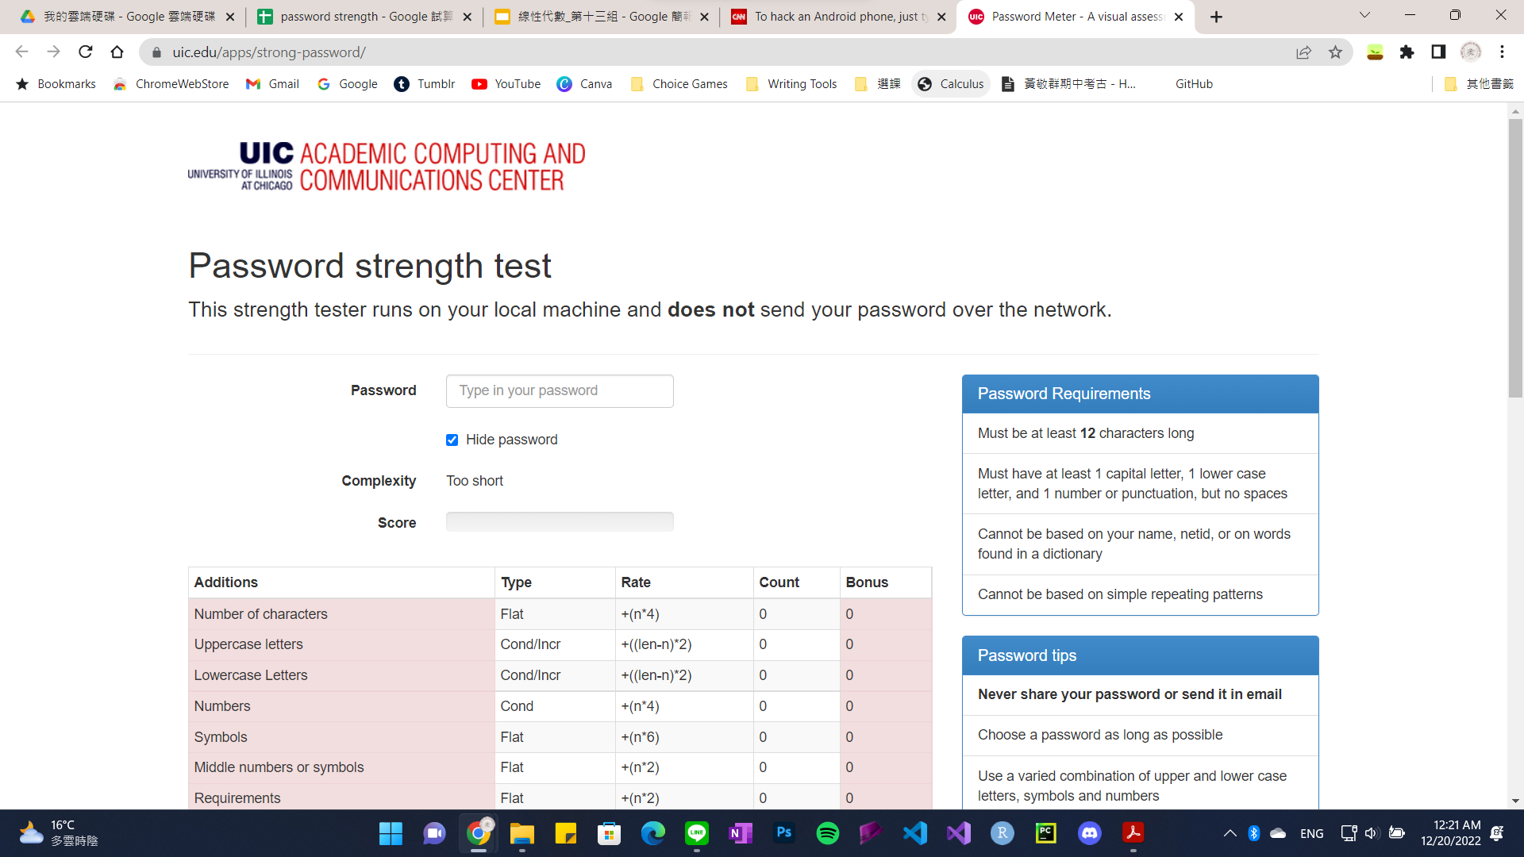
THE UIC PASSWORD STRENGTH TEST
MATRICES APPLIED IN CRYPTOGRAPHY
EVALUATION.HTML
Notes:
So after obtaining hypothetical passwords from our survey, we ran both encrypted and non-encrypted passwords by the UIC password strength test.

Slide 26
UIC RUBRICS FOR EVALUATING STRENGTH
MATRICES APPLIED IN CRYPTOGRAPHY
The points below are added up to a maximum total of 100.
ADDITION POINTS
DETAILED RUBRICS
Points are added for increased variety
ARE FEATURED ON THE
NEXT PAGE
DEDUCTION POINTS
Points are taken away if certain conditions are met
EVALUATION.HTML
Notes:
But how does the website test if a password is strong? The password tests assigns positive and negative points to each password, which itself is evaluated against a rubric.

Slide 27
POINTS FOR ADDITION
MATRICES APPLIED IN CRYPTOGRAPHY
 | Rate
Number of char | +4n
Upper/lowercase Letters | +2(len-n)
Numbers | +4n
Symbols | +6n
Numbers/Symbols in the middle | +2n
Requirements met | +2n
* n refers to the total amount of occurences for each category
EVALUATION.HTML
Notes:
The rubrics for positive points vary with the specific requirements.

Slide 28
POINTS FOR DEDUCTION
MATRICES APPLIED IN CRYPTOGRAPHY
 | Rate
Letters only | −n
Numbers only | −n
Repeat Characters | −
Consecutive upper/lowercase letters | −2n
Consecutive numbers | −2n
Sequential letters/numbers/symbols | −3n
* n refers to the total amount of occurences for each category
EVALUATION.HTML
Notes:
The same goes for the points for deduction.

Slide 29
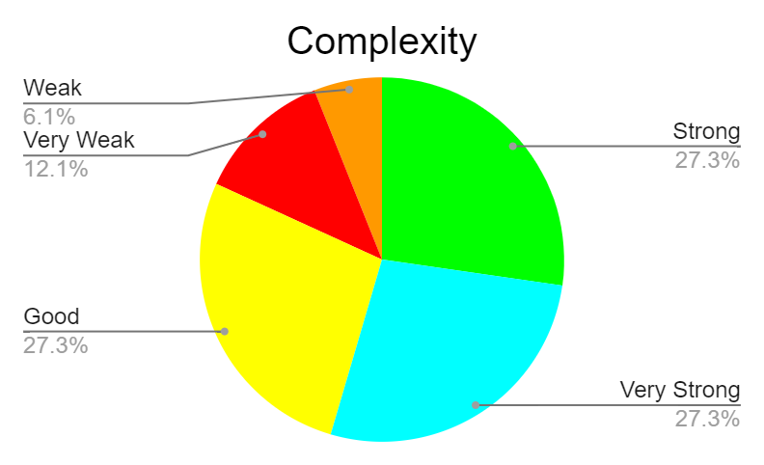
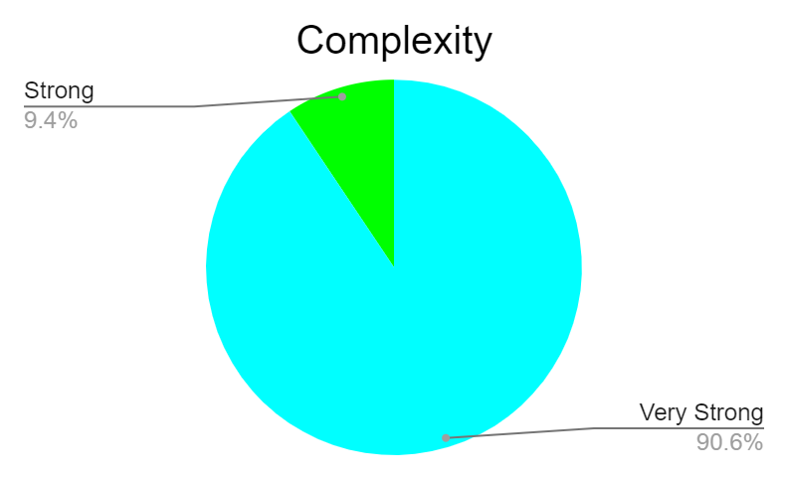
SOCIAL
MATRICES APPLIED IN CRYPTOGRAPHY
Non-encrypted
Encrypted
EVALUATION.HTML

Slide 30
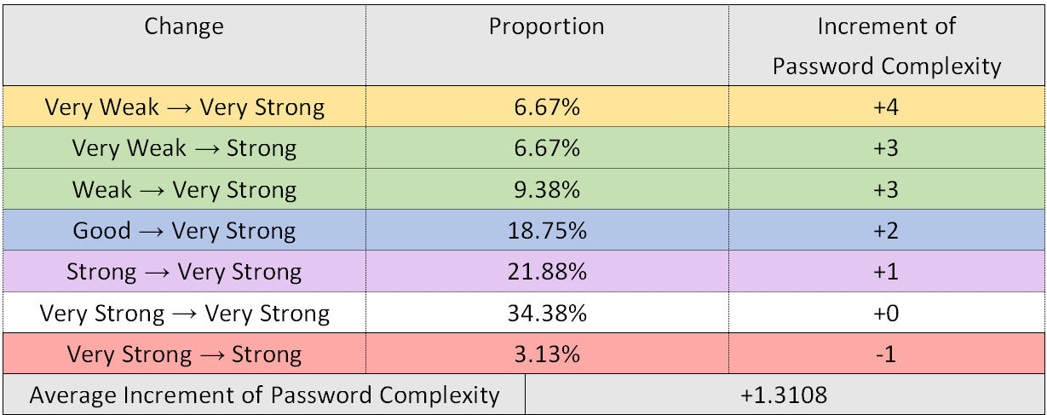
SOCIAL
MATRICES APPLIED IN CRYPTOGRAPHY
EVALUATION.HTML

Slide 31
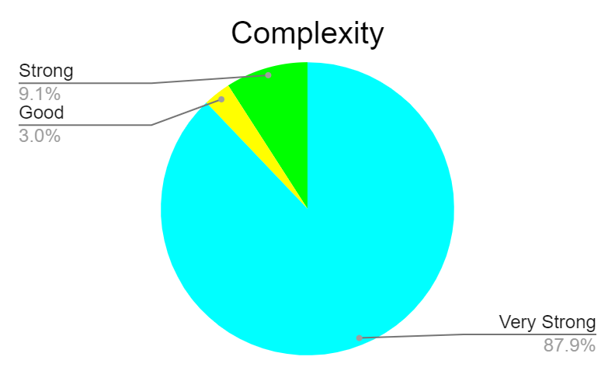
E-MAIL
MATRICES APPLIED IN CRYPTOGRAPHY
Non-encrypted
Encrypted
EVALUATION.HTML

Slide 32
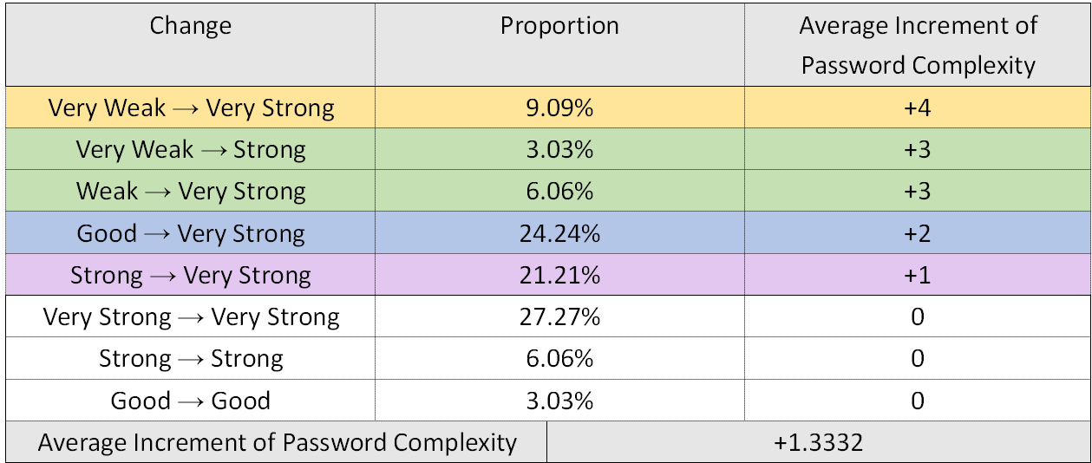
E-MAIL
MATRICES APPLIED IN CRYPTOGRAPHY
EVALUATION.HTML

Slide 33
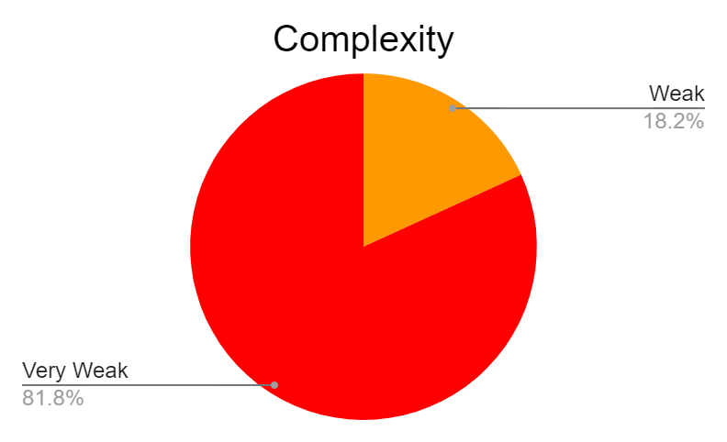
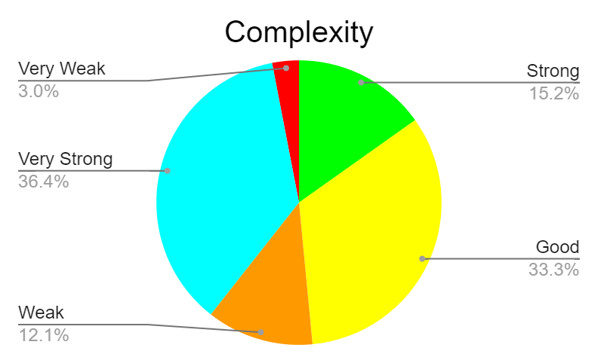
PHONE
MATRICES APPLIED IN CRYPTOGRAPHY
Non-encrypted
Encrypted
EVALUATION.HTML

Slide 34
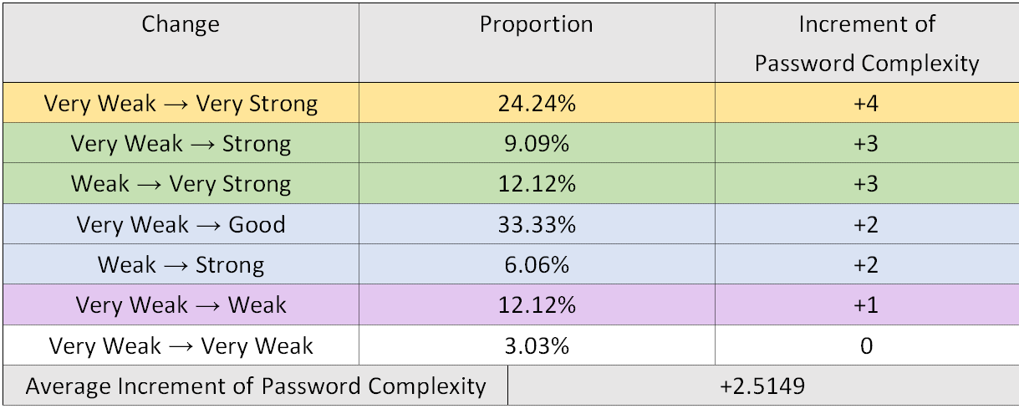
PHONE
MATRICES APPLIED IN CRYPTOGRAPHY
EVALUATION.HTML

Slide 35
VALIDATION
MATRICES APPLIED IN CRYPTOGRAPHY
Background of the Research Paper:
Title: Design and Evaluation of a Data-Driven Password Meter
Authors: CyLab Usable Privacy and Security Laboratory from Carnegie Mellon University
Published: 02 May 2017
EVALUATION.HTML

Slide 36
VALIDATION
MATRICES APPLIED IN CRYPTOGRAPHY
Users sometimes make predictable passwords…
related to words and phrases
specific characters are in predictable locations
keyboard patterns like “asdfghj”
Users frequently reuse passwords
EVALUATION.HTML

Slide 37
VALIDATION
MATRICES APPLIED IN CRYPTOGRAPHY
Our method resolves the problems!
randomly generated matrix
⇒ lower possibility of:
predictable locations of characters
common keyboard patterns, words, and phrases
generate new passwords of higher security easily
EVALUATION.HTML

Slide 38
04
CONCLUSION
MATRICES APPLIED IN CRYPTOGRAPHY
& References!
CONCLUSION.HTML
Notes:
So now we come to our conclusion!

Slide 39


MOST PASSWORDS ARE WEAK
MATRICES APPLIED IN CRYPTOGRAPHY
CONCLUSION.HTML
Notes:
We observed that most passwords are overused and guessable

Slide 40
MATRICES WERE MADE TO ENCRYPT THEM
MATRICES APPLIED IN CRYPTOGRAPHY
CONCLUSION.HTML
Notes:
2. We decided to make matrices to encrypt said passwords

Slide 41

98.43% OF COLLECTED PASSWORDS
BECAME STRONGER
MATRICES APPLIED IN CRYPTOGRAPHY
CONCLUSION.HTML
Notes:
3. We succeeded in making over 98.43 percent of the collected passwords stronger.

Slide 42
REFERENCES
YOUR LOGO HERE
[1] Ur, B., Alfieri, F., Aung, M., Bauer, L., Christin, N., Colnago, J., ... & Melicher, W. (2017, May). Design and evaluation of a data-driven password meter. In Proceedings of the 2017 chi conference on human factors in computing systems (pp. 3775-3786).
[2] Password Meter - A visual assessment of password strengths and weaknesses. (n.d.). https://www.uic.edu/apps/strong-password/
[3] Dell'Amico, M., Michiardi, P., & Roudier, Y. (2010, March). Password strength: An empirical analysis. In 2010 Proceedings IEEE INFOCOM (pp. 1-9). IEEE.
[4] Wheeler, D. L. (2016). zxcvbn:{Low-Budget} Password Strength Estimation. In 25th USENIX Security Symposium (USENIX Security 16) (pp. 157-173).
[5] Kelley, P. G., Komanduri, S., Mazurek, M. L., Shay, R., Vidas, T., Bauer, L., ... & Lopez, J. (2012, May). Guess again (and again and again): Measuring password strength by simulating password-cracking algorithms. In 2012 IEEE symposium on security and privacy (pp. 523-537). IEEE.
[6] Yan, J., Blackwell, A., Anderson, R., & Grant, A. (2004). Password memorability and security: Empirical results. IEEE Security & privacy, 2(5), 25-31.
INDEX.HTML
Notes:
These are our references.

Slide 43
THANKS!
MATRICES APPLIED IN CRYPTOGRAPHY
Here’s the final program again!
DO YOU HAVE ANY QUESTIONS?
FEEL FREE TO ASK US!
THANKS.HTML
Notes:
We thank you for listening to our presentation! If there are any questions, feel free to ask us! And if you’re interested to know how our code works, you can scan the QR code above!

